Slide 1
Activity Update
Jenna Dickman
Undergraduate Research
Berkeley Autonomous Microsystems Lab, BSAC

Slide 2
Overall Goal: Drone detection for micro-missiles
Goal 1
ID drone with model on AIY vision kit
Goal 2
Effectively ID drone with model on AIY vision kit
Goal 3
Get it all to work on very small hardware

Slide 3
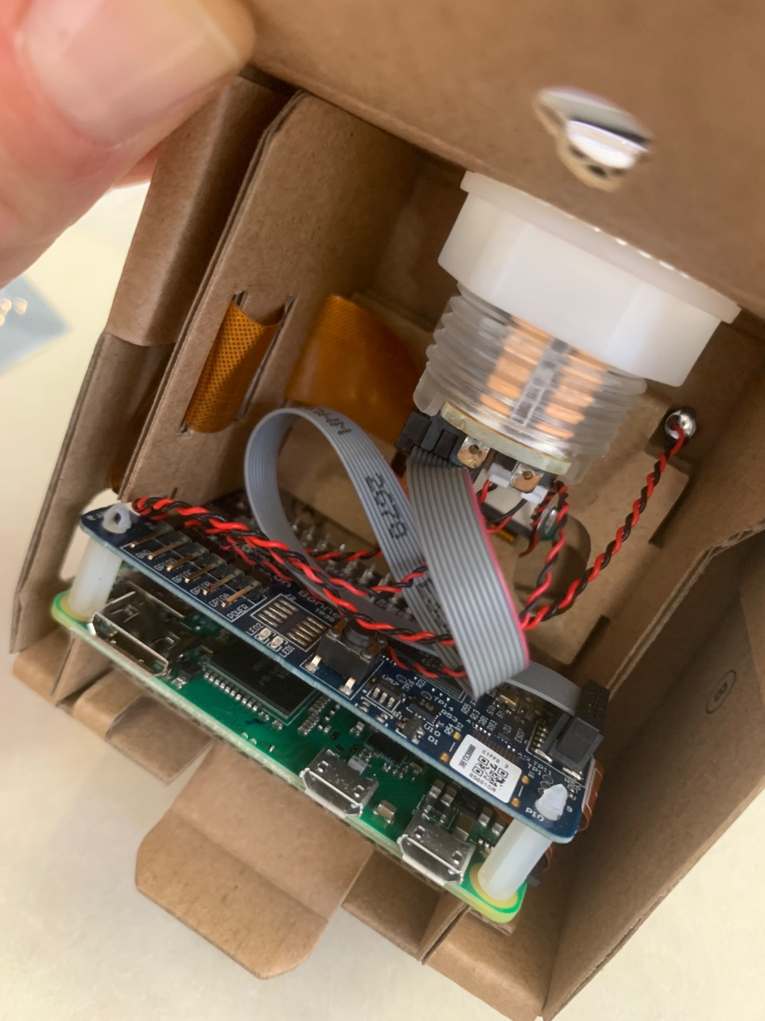
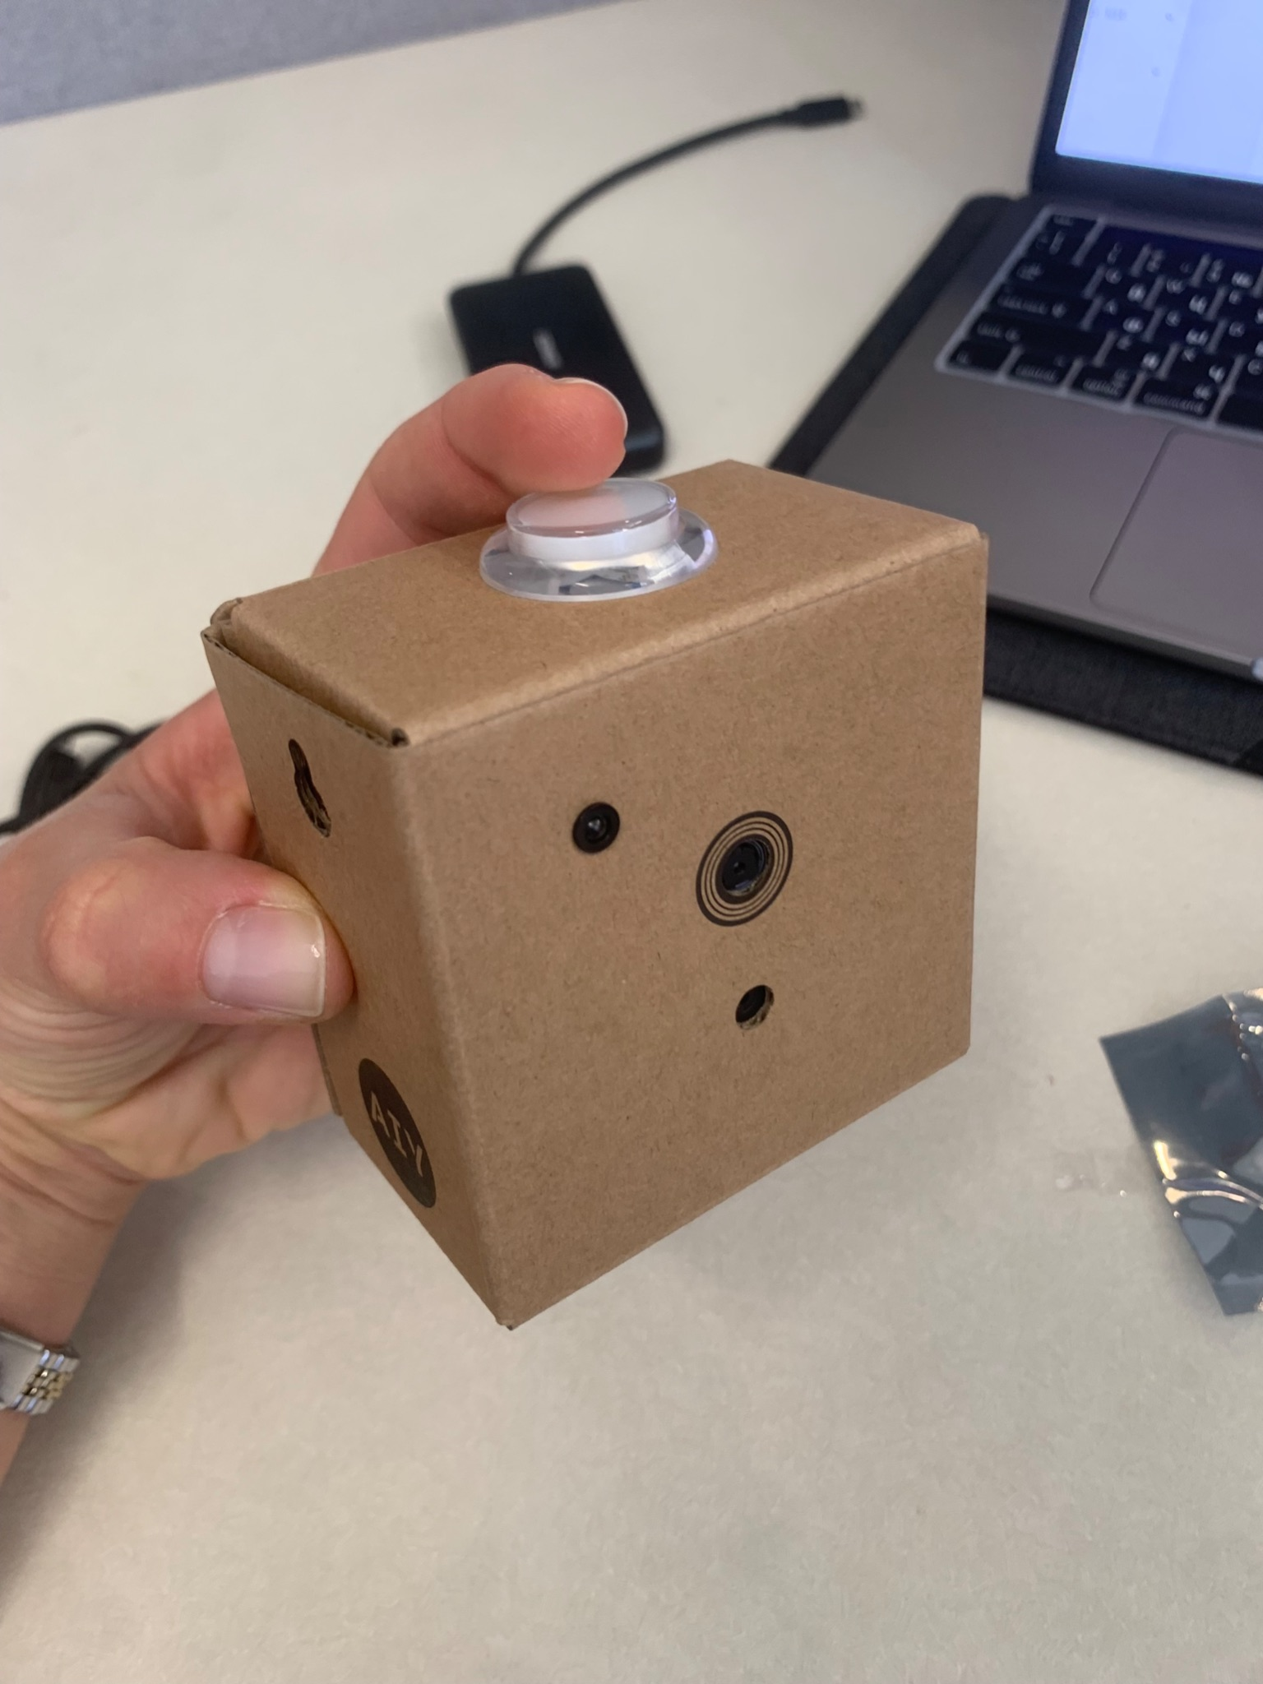
Drone detector progress
Test run of model training
Trained yolov5s pre-trained model on 1039 images for 15 epochs
Validated with 154 images, achieved 79.4% precision
Obviously need to train it a lot longer. 100 epochs would take 20 hours on my laptop so looking into cloud options
Assembled and set up AIY vision kit
It’s working!
Currently running a demo model - happiness detector!

Slide 4
Next steps
Get to know the AIY interface, hook up peripherals
Convert the model to TensorFlow Lite
Compile for Edge TPU
Deploy to AIY Vision Kit
Integrate camera feed
Test tester-model with basic drone images
Iterate
What else do I need to consider? What questions should I be asking?
Learn more about SCuM, tiny cameras, MEMs controls. What would it take to run an effective AI model on tiny hardware?

